Slide 1
UHV-I Session 14 Sum Up and Future Program

Slide 2
Interaction Before Main Session
Hear from participants about their exploration from previous day(s)
Q&A
Place some expected conclusions, find out if they also came to these/similar conclusions

Slide 3
Home Assignment
13.1. What are some of the activities, projects, etc. you can do to contribute to the harmony in nature?
We can see that global warming and resource depletion are two major problems of the current time. Find out
- Are these natural occurrences or are they due to lack of right understanding in human being?
- Do we, human beings, have a role to play in nature?
To further develop the harmony in nature (at least not to disturb the harmony in nature)
To make right utilisation of the physical facility (after all it comes from the rest of nature)
To evolve a way of living in harmony with nature

Slide 4
UHV-I Session 14 Sum Up and Future Program

Slide 5
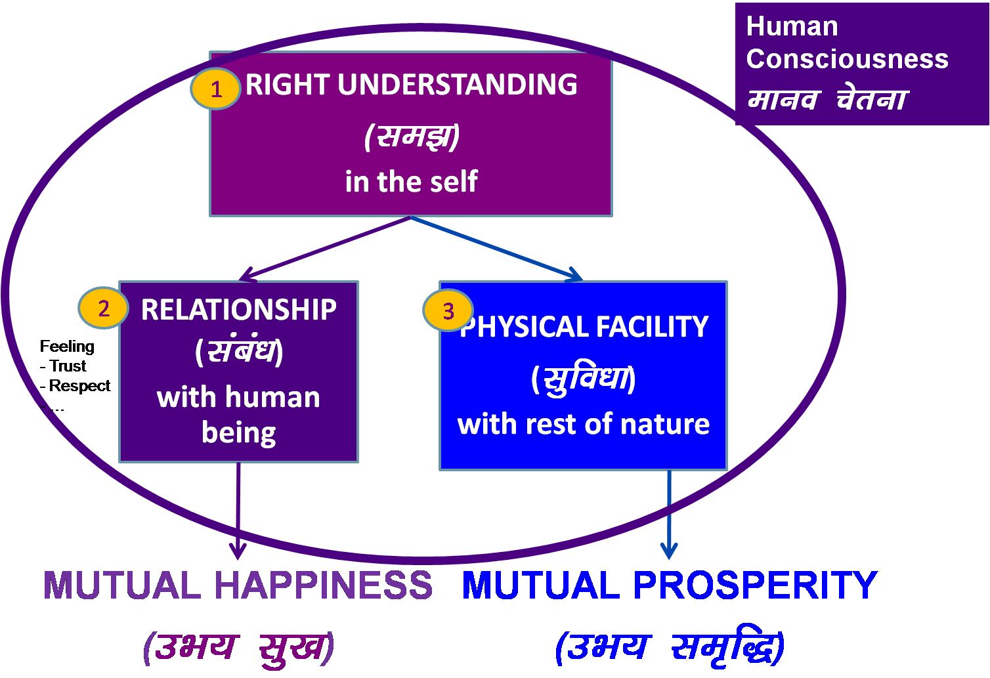
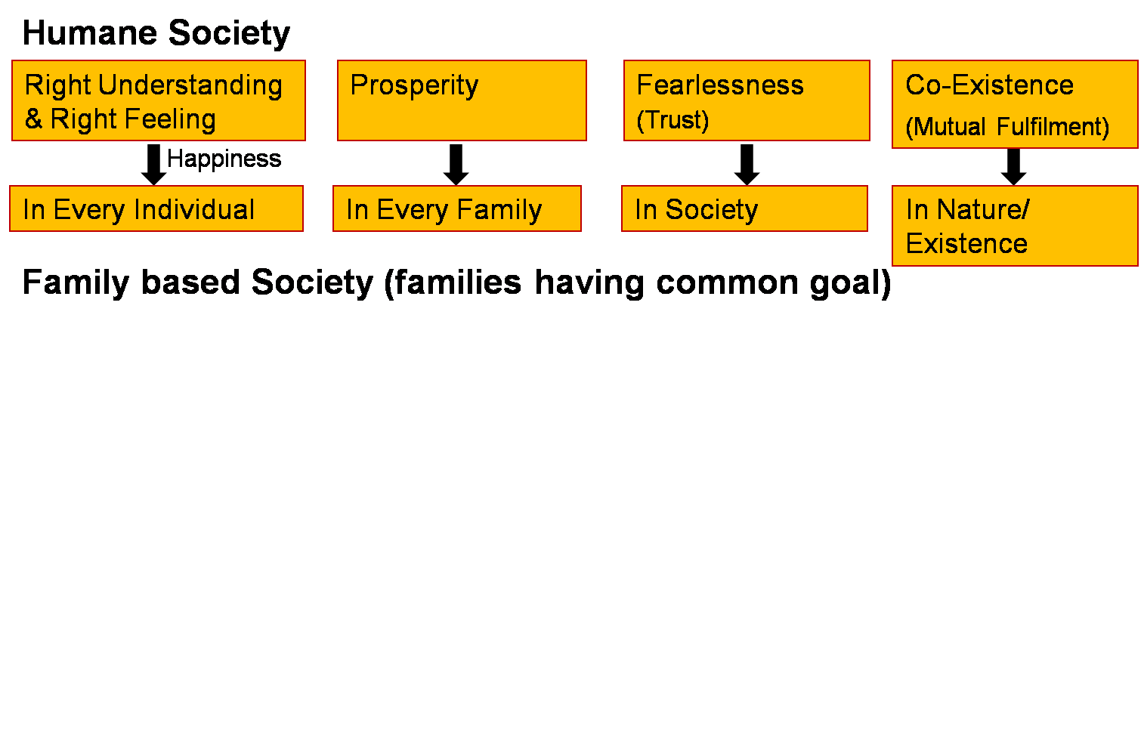
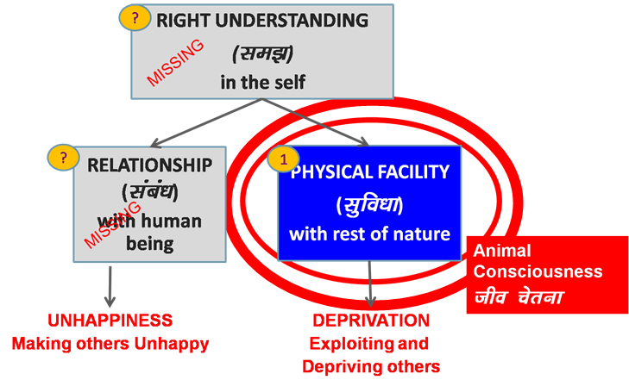
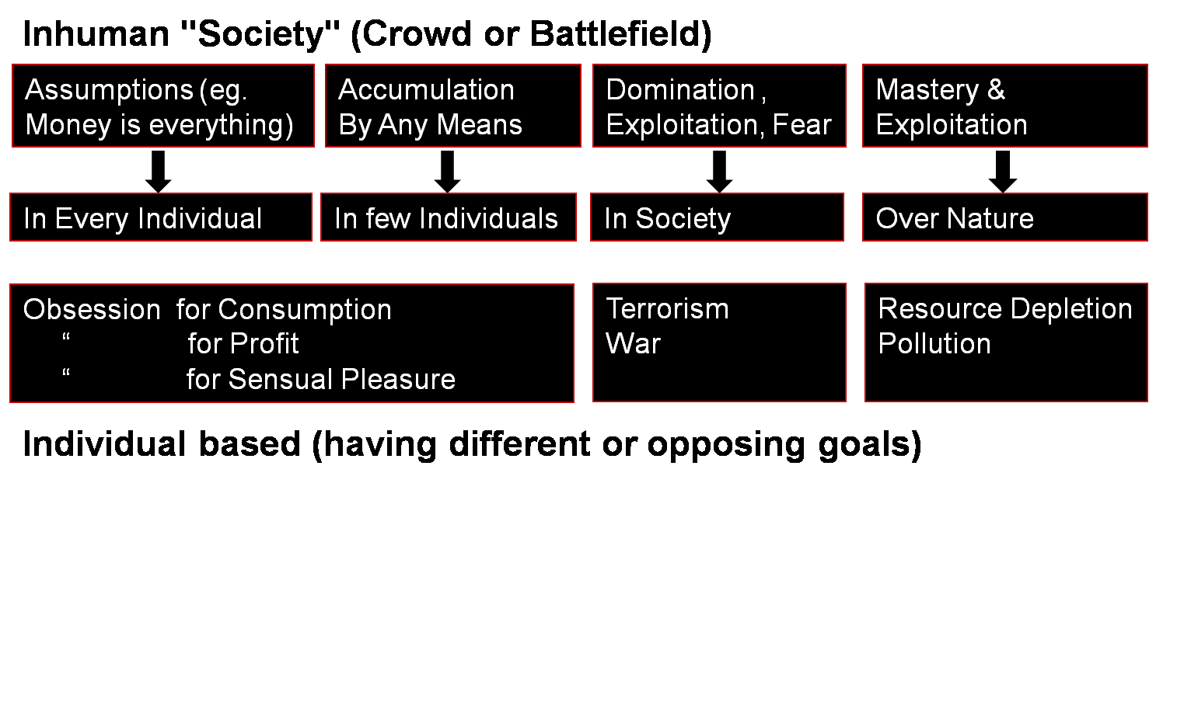
We are responsible for the realization of the human goal
We need to understand and participate actively
In developing ourselves
In contributing to the development of society
Transformation& Progress
laØe.k&fodkl
Human Education
Personal Transformation
Societal Transformation

Slide 6
UHV-I: Our Journey to Understanding
Session | Title | Underlying Reality
Ind 1 | Introduction Welcome, course overview, getting to know each other
Ind 2 | Exploring our aspirations and concerns Planning for a fulfilling life by relating academic success, career… expectations of family, peers… to our basic aspiration… | Basic human aspiration
Ind 3 | Basic human aspiration and its fulfilment Setting correct priorities in life | Human consciousness
Ind 4 | Program for fulfilment of basic human aspiration Shifting from excitement to happiness… | Understanding harmony
Ind 5 | Fulfilment of aspirations at individual level Distinguishing between the needs of Self and Body | Harmony in human being
Ind 6 | Resolution of concerns at individual level Developing self-confidence, overcoming peer pressure | Harmony in the Self
Ind 7 | Ensuring health holistically Making a definite program for health | Harmony between Self and Body

Slide 7
UHV-I: Our Journey to Understanding
Session | Title | Underlying Reality
Ind 8 | Fulfilment in relationship – Trust Resolving anger, irritation, fear… | Harmony in family
Ind 9 | Fulfilment in relationship – Trust Shifting from reaction to response in relationship… | Harmony in family
Ind 10 | Fulfilment in relationship – Respect Shifting from differentiation to complementarity… | Harmony in family
Ind 11 | Fulfilment in relationship – Other Feelings Shifting from competition to excellence, infatuation to love… | Harmony in family
Ind 12 | Understanding our role in society Contributing towards fulfilment of a common human goal in the society (institution… state… nation… world) | Harmony in society
Ind 13 | Understanding our role in nature Contributing towards harmony in nature | Harmony in nature/existence
Ind 14 | Sum up and Program
Ind 15 | Sharing, self-evaluation

Slide 8
Universal Human Values
Human value is the participation of human being for the harmony in the larger order
In the Self - to develop the understanding of harmony (right understanding) and feeling of harmony (feeling of relationship, i.e., right feeling) → happiness
With the Body - to ensure health holistically, and ensure its right utilisation
In the family - to share the feeling of harmony, and ensure prosperity
in the society - to participate in the harmony in the society
in nature/existence - to participate in the harmony in nature

Slide 9
Sum Up
At the core of it
we want to be always happy and prosperous,
we want to be healthy,
we want to live in relationship in the family, with friends, in the institution…with every human being,
we want to live in a just and equitable society and
we want to have a conducive natural environment
We also do not want problems
For fulfilling our aspirations (and for resolving our problems), we have to understand, ensure the right feeling in ourself and participate in a meaningful manner in the larger systems in the family, society and nature
There is every provision for this…
only we have to make the effort in this direction
We have to develop a holistic, humane world-vision…

Slide 10
Program of Action

Slide 11
Program of Action (Individual)
To understand harmony and to live in harmony
– at all levels of being (individual, family, society, nature/existence)
i.e., to develop a holistic, humane world-vision and the skills to live accordingly

Slide 12
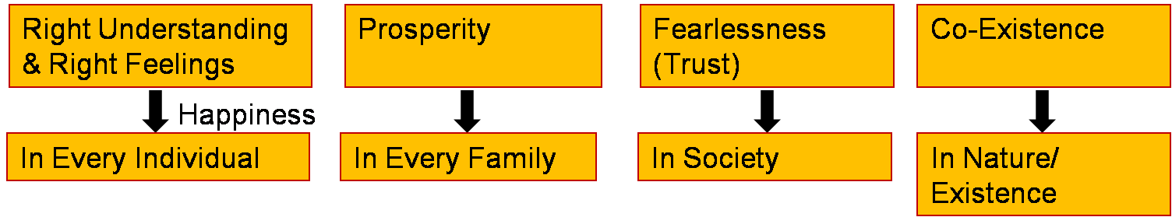
Program of Action (at the level of Society)
People’s Education Program : for adults
Education-Sanskar Program : for children
Program for Humane Society
Just as a seed replicates itself, so the vision of an Undivided Society and Universal Human Order can be evidenced on this planet…
Family – Family cluster – Village – Village cluster ... State ... Nation ... World Family
10 yrs 1
Next 10 yrs 10
100 yrs 1000 cr
People with Right Understanding & Right Feelings
Parents - Policy Makers
Teachers …
20-50 yrs
People with Right Understanding & Right Feelings
- People with definite Human conduct, the competence to participate in Universal Human Order
Courses in Academic Curriculum
Socially Relevant Projects
Conducive Environment
10-20 yrs
Fulfilment of Human Goal

Slide 13
Next Steps
UHV-I will be followed with regular meetings with your faculty mentor and your student buddy
You can also do your internship in social organisations and volunteer for the efforts for society
This will help in the development in the state as well as the Nation
Next semester or next year, a full one-semester UHV course will be offered with detailed inputs
It is called UHV-II: A Foundation Course in Universal Human Values and Professional Ethics (aka Understanding Harmony and Ethical Human Conduct)
It is the next step
To understand harmony and to live in harmony
– at all levels of being (individual, family, society, nature/existence)
i.e. to develop a holistic, humane world-vision and the skills to live accordingly
Best Wishes!

Slide 14
Home Assignment

Slide 15
Prepare your Self Evaluation (3-5 minutes each)
In the next session, some of you will be requested to share
1. Your brief introduction (30 sec)
2. Your key learning from this UHV orientation (3-4 min)
- Three key proposals you could verify, experiment (share a relevant incident)
- Thoughts before and thoughts now
(about happiness, prosperity, excellence, competition etc.)
3. Your commitment – Specific future plans related to UHV (30 sec)
You will need to be mindful of the time (3-5 minutes)
And also stick to the 3 points, above

Slide 16
Questions?

